Slide 1
MATLAB PRESENTATION
By GROUP 11

Slide 2
Group 11 MEMEBERS
NAME | REGISTRATION NUMBER | PROGRAM OF STUDY
MUKYALA ROSE MIIRIAM | BU/UP/2024/1041 | WAR
OGWANG EMMANUEL | BU/UP/2024/3254 | WAR
NSAMBA SHAFFIC | BU/UP/2024/5346 | MEB
KAGODA ENOCK | BU/UP/2023/1097 | WAR
BUSUULWA HASSAN | BU/UP/2024/3732 | AMI
WAMBI KENNETH | BU/UP/2023/0950 | PTI
ATWIINE SANDRAH | BU/UG/2024/2632 | MEB
ABESIGA KEITH ADAMS | BU/UP/2024/3974 | AMI
WASSWA FRANCIS | BU/UG/2024/2669 | APE
NANDERA JULIET | BU/UP/2024/1047 | WAR

Slide 3
MATLAB
Also known as Matrix Laboratory
first developed in the late 1970s as a simple interactive basic matrix calculator.
officially launched as a commercial product in 1984 by MathWorks.
it has introduced several specialized toolboxes for various applications, including control systems and signal processing.
The Simulink environment further allows users to model and simulate dynamic systems graphically.
Recent versions have introduced features like the Live Editor, which allows users to create interactive documents that combine code, output, and formatted text

Slide 4
Number one
Import data from Kaggle.com to the computer
Import the saved data to MATLAB using the function “readtables”
Separate the table into different tables based on the various years.
Convert the tables into structural arrays using the function “table2struct”
Convert the arrays back into tables using the function “struct2table”
Export the tables into excel in their respective years in the same workbook but separate sheets.

Slide 5
codes
Extracting the table from the file
T = readtable("C:\Users\GROW\Desktop\group 11 matlab assignment\number 1\1a_vgsales.csv","ReadVariableNames",true);
disp(T);

Slide 6
Separating data for each year into different tables
vg_2010 = T(T.Year == 2010, :);
vg_2011 = T(T.Year == 2011, :);
vg_2012 = T(T.Year == 2012, :);
vg_2013 = T(T.Year == 2013, :);
vg_2014 = T(T.Year == 2014, :);
vg_2015 = T(T.Year == 2015, :);
vg_2016 = T(T.Year == 2016, :);
vg_2017 = T(T.Year == 2017, :);

Slide 7
Constructing arrays for each year
vg_a_2010 = table2struct(vg_2010);
vg_a_2011 = table2struct(vg_2011);
vg_a_2012 = table2struct(vg_2012);
vg_a_2013 = table2struct(vg_2013);
vg_a_2014 = table2struct(vg_2014);
vg_a_2015 = table2struct(vg_2015);
vg_a_2016 = table2struct(vg_2016);
vg_a_2017 = table2struct(vg_2017);

Slide 8
Converting the arrays into tables for export
vg_2_2010 = struct2table(vg_a_2010);
vg_2_2011 = struct2table(vg_a_2011);
vg_2_2012 = struct2table(vg_a_2012);
vg_2_2013 = struct2table(vg_a_2013);
vg_2_2014 = struct2table(vg_a_2014);
vg_2_2015 = struct2table(vg_a_2015);
vg_2_2016 = struct2table(vg_a_2016);
vg_2_2017 = struct2table(vg_a_2017);

Slide 9
PLOTS
Rank=categorical(vg_2_2010.Rank);
genre=categorical(vg_2_2010.Genre);
naSale=categorical(vg_2_2010.NA_Sales);
publisher=categorical(vg_2_2010.Publisher);
euSale=categorical(vg_2_2010.EU_Sales);
globalSale=categorical(vg_2_2010.Global_Sales);
jpSales=categorical(vg_2_2010.JP_Sales);
platforms=categorical(vg_2_2010.Platform);
othersales=categorical(vg_2_2010.Other_Sales);

Slide 10
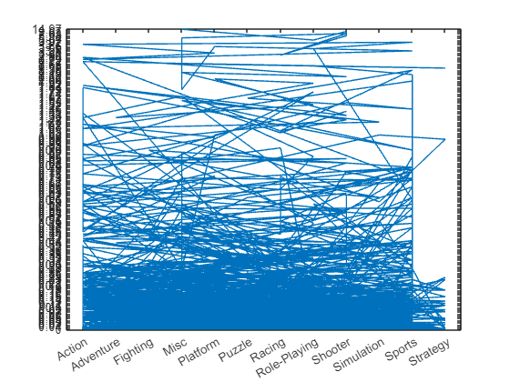
plot(genre,naSale);

Slide 11
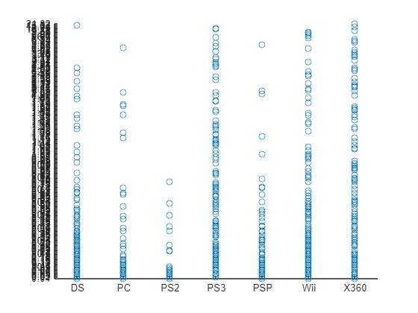
scatter
scatter(platforms,globalSale);

Slide 12
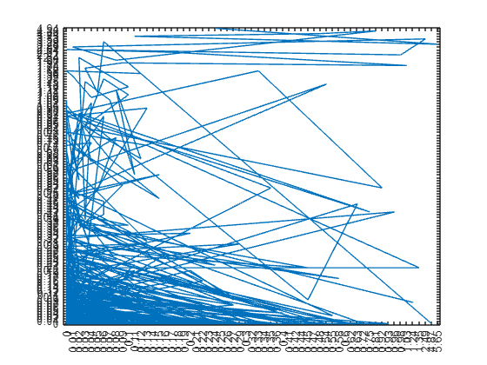
plot
plot(jpSales,euSale);

Slide 13
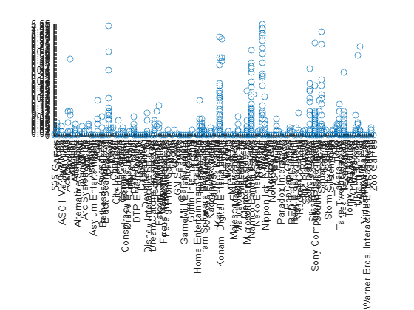
scatter
scatter(publisher,jpSales);

Slide 14
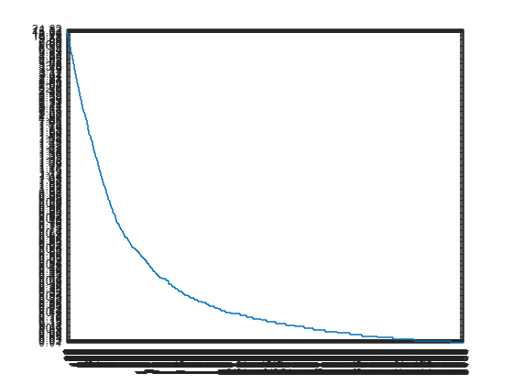
step plot
stairs(Rank,globalSale);

Slide 15
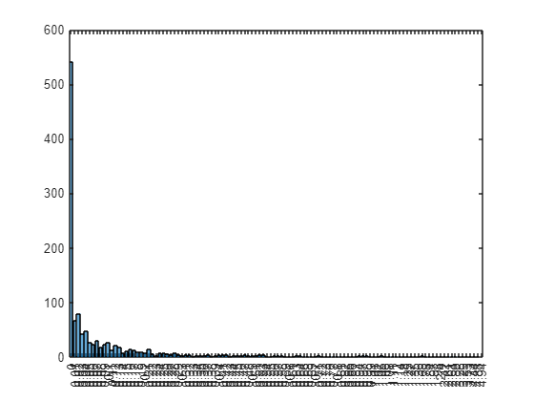
histogram
histogram(euSale);

Slide 16
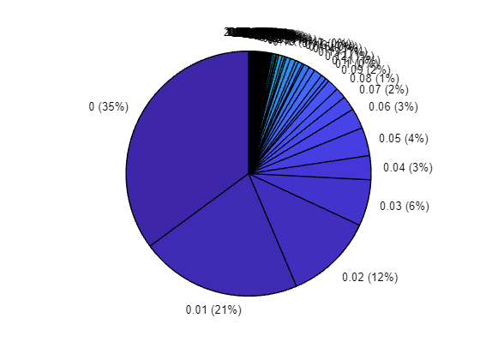
pie chart
pie(othersales);

Slide 17
Output of each of the variables into a single workbook with each year on separate worksheets
writetable(vg_2_2010,"ASSIGNMENT_TABLE.xlsx","Sheet","2010","WriteVariableNames",true);
writetable(vg_2_2011,"ASSIGNMENT_TABLE.xlsx","Sheet","2011","WriteVariableNames",true);
writetable(vg_2_2012,"ASSIGNMENT_TABLE.xlsx","Sheet","2012","WriteVariableNames",true);
writetable(vg_2_2013,"ASSIGNMENT_TABLE.xlsx","Sheet","2013","WriteVariableNames",true);
writetable(vg_2_2014,"ASSIGNMENT_TABLE.xlsx","Sheet","2014","WriteVariableNames",true);
writetable(vg_2_2015,"ASSIGNMENT_TABLE.xlsx","Sheet","2015","WriteVariableNames",true);
writetable(vg_2_2016,"ASSIGNMENT_TABLE.xlsx","Sheet","2016","WriteVariableNames",true);
writetable(vg_2_2017,"ASSIGNMENT_TABLE.xlsx","Sheet","2017","WriteVariableNames",true);

Slide 18
NUMBER 2
Steps involved.
Step1; open and launch MATLAB
Step 2; click on new script to open editor
Step 3; acquiring each member’s affirmative information
Step 4; generating a MATLAB code that can store each member’s attributes like age, date of birth, district etc. in a table
Step 5;create plots and graphs
Step 6; run the achieved code in MATLAB as shown below.

Slide 19
Data input
NAME = ["WASSWA FRANCIS"; "NANDERA JULIET"; "ATWINE SANDRAH"; "WAMBI KENNETH"; "OGWANG EMMANUEL"; "ABESIGA KEITH ADAMS"; "BUSUULWA HASSAN"; "KAGODA ENOCK";"MUKYALA ROSE MIRIAM";"NSAMABA SHAFFIC"];
TRIBAL_BACKGROUND = ["MUGANDA"; "MUNYORE"; "MUNYANKORE"; "MUSOGA"; "LANGI"; "MUNYANKOLE"; "MUGANDA"; "MUSOGA";"MUGWERE";"MUGANDA"];
HOME_DISTRICT = ["WAKISO"; "BUGIRI"; "BUHWEHJU"; "JINJA"; "LIRA"; "RUKUNGIRI"; "WAKISO";"JINJA";"KIBUKU";"WAKISO"];
RELIGION = ["CATHOLIC"; "ANGLICAN"; "ANGLICAN"; "ANGLICAN"; "SDA"; "PENTECOSTAL"; "ATR"; "CATHOLIC"; "ANGLICAN"; "BORN AGAIN"];
COURSE = ["APE"; "WAR"; "MEB"; "PTI"; "WAR"; "AMI"; "AMI";"WAR";"WAR";"MEB"];
INTERESTS = ["DRIVING"; "MONEY"; "READING NOVELS"; "DEBATING"; "TECH"; "SWIMMING"; "BOXING";"READING";"SINGING";"FOOTBAL"];

Slide 20
FACIAL_REPRESENTATION = {imread("C:\Users\GROW\Desktop\group 11 matlab assignment\number 2\WASSWA.jpg"); imread("C:\Users\GROW\Desktop\group 11 matlab assignment\number 2\NANDERA.jpg"); imread("C:\Users\GROW\Desktop\group 11 matlab assignment\number 2\ATWIINE.jpg"); imread("C:\Users\GROW\Desktop\group 11 matlab assignment\number 2\WAMBI.jpg"); imread("C:\Users\GROW\Desktop\group 11 matlab assignment\number 2\OGWANG.jpg"); imread("C:\Users\GROW\Desktop\group 11 matlab assignment\number 2\ABESIGA .jpg"); imread("C:\Users\GROW\Desktop\group 11 matlab assignment\number 2\BUSUULWA.jpg"); imread("C:\Users\GROW\Desktop\group 11 matlab assignment\number 2\KAGODA.jpg"); imread("C:\Users\GROW\Desktop\group 11 matlab assignment\number 2\MIRIAM.jpg"); imread("C:\Users\GROW\Desktop\group 11 matlab assignment\number 2\NSAMBA.jpg")}

Slide 21
FACIAL_REPRESENTATION = 10×1 cell
 | 1
1 | 1280×1234×3 uint8
2 | 960×505×3 uint8
3 | 1280×1234×3 uint8
4 | 1080×607×3 uint8
5 | 1080×1080×3 uint8
6 | 1080×810×3 uint8
7 | 1080×540×3 uint8
8 | 1280×720×3 uint8
9 | 1080×486×3 uint8
10 | 831×856×3 uint8
AGE = [21; 20; 23; 21; 22; 23; 22; 23; 22; 20];

Slide 22
Organization of Data into single table variable
Studentdata = table(NAME,COURSE,AGE,TRIBAL_BACKGROUND,HOME_DISTRICT,RELIGION,INTERESTS,FACIAL_REPRESENTATION); disp(Studentdata);
NAME COURSE AGE TRIBAL_BACKGROUND HOME_DISTRICT RELIGION INTERESTS FACIAL_REPRESENTATION
_____________________ ______ ___ _________________ _____________ _____________ ________________ _____________________
"WASSWA FRANCIS" "APE" 21 "MUGANDA" "WAKISO" "CATHOLIC" "DRIVING" {1280×1234×3 uint8}
"NANDERA JULIET" "WAR" 20 "MUNYORE" "BUGIRI" "ANGLICAN" "MONEY" { 960×505×3 uint8}
"ATWINE SANDRAH" "MEB" 23 "MUNYANKORE" "BUHWEHJU" "ANGLICAN" "READING NOVELS" {1280×1234×3 uint8}
"WAMBI KENNETH" "PTI" 21 "MUSOGA" "JINJA" "ANGLICAN" "DEBATING" {1080×607×3 uint8}
"OGWANG EMMANUEL" "WAR" 22 "LANGI" "LIRA" "SDA" "TECH" {1080×1080×3 uint8}

Slide 23
"ABESIGA KEITH ADAMS" "AMI" 23 "MUNYANKOLE" "RUKUNGIRI" "PENTECOSTAL" "SWIMMING" {1080×810×3 uint8}
"BUSUULWA HASSAN" "AMI" 22 "MUGANDA" "WAKISO" "ATR" "BOXING" {1080×540×3 uint8}
"KAGODA ENOCK" "WAR" 23 "MUSOGA" "JINJA" "CATHOLIC" "READING" {1280×720×3 uint8}
"MUKYALA ROSE MIRIAM" "WAR" 22 "MUGWERE" "KIBUKU" "ANGLICAN" "SINGING" {1080×486×3 uint8}
"NSAMABA SHAFFIC" "MEB" 20 "MUGANDA" "WAKISO" "BORN AGAIN" "FOOTBAL" { 831×856×3 uint8}
Saving the data
save("Studentdata.mat", "Studentdata");

Slide 24
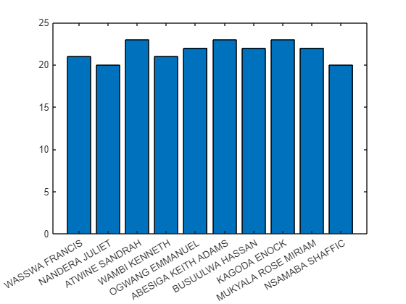
PLOTS;
bar(NAME,AGE);

Slide 25
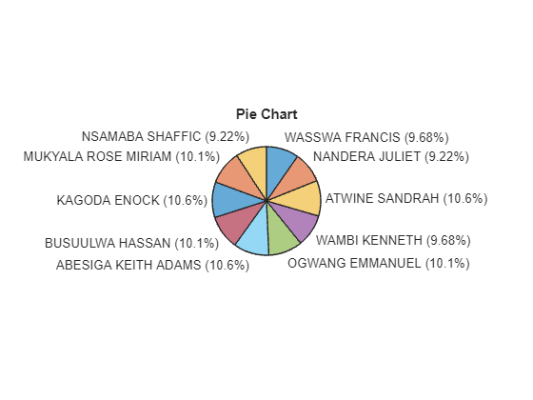
piechart(AGE,NAME);
title('Pie Chart');

Slide 26
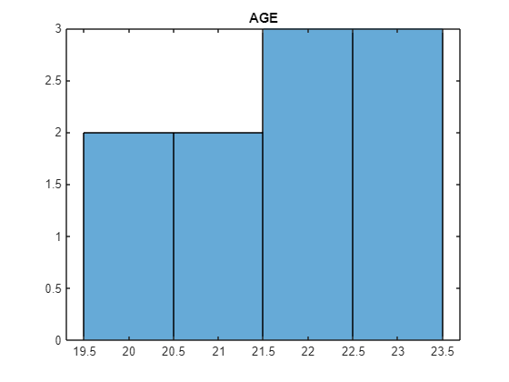
HISTOGRAM
histogram(AGE);
title('AGE');
save("Studentdata.mat","Studentdata");

Slide 27
Conclusion
We learnt how to manipulate huge datasets using matlab.

